Slide 1
Toastmaster
Speech Contest
Chief Judge Training Online
Michael Alexander, DTM
<Michael@AlexanderTalks.com>

Slide 2
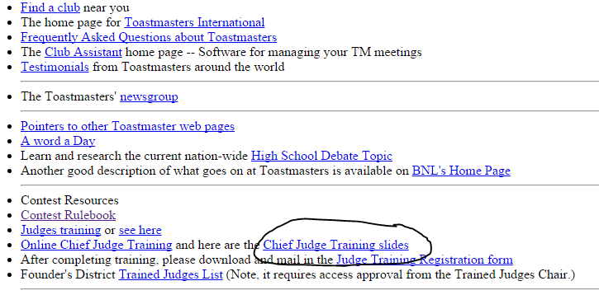
Copies of these slides can be obtained at: http://AlexanderTalks.com/toast.html

Slide 3
Judge’s Training
You should really be familiar with the Judging rules, so if you have not already taken Judge’s training, please do so before continuing. There is an online version at:
http://www.toastmasters.org/Leadership-Central/Speech-Contests/Speech-Contest-Tutorials
Note: It is best if you do not serve as a Chief Judge, until you are comfortable as a judge.

Slide 4
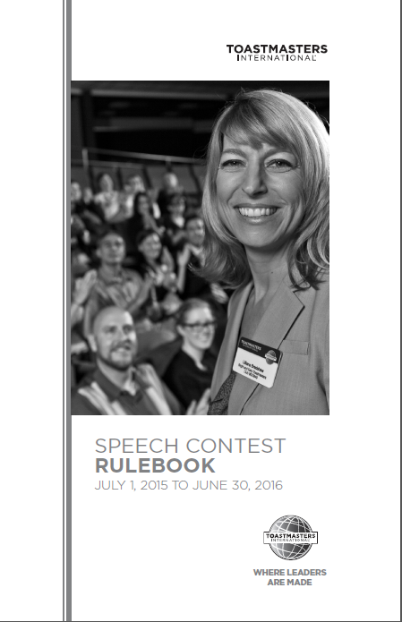
http://tinyurl.com/TMrules2015

Slide 5
Agenda
  Types of Contests
  Role of Chief Judge
  Key Players
  Pre-Contest Preparation
  Checklist
    Before
    During
    After
      Review Forms to be filled out
  Additional Resources

Slide 6
Types of Contests
Fall Contest
    Evaluation
    Humorous/Tall Tales
Spring Contest
    Table Topics
    International Speech

Slide 7
What is the Responsibility of the Chief Judge?
Ensure that the contest is conducted fairly.
Ensure that the contest is conducted according to the Contest rules and all the players perform their tasks properly.
Interpret the rules and make any necessary decisions pertaining to them.
Provide all paperwork necessary to run the contest.
Select a WINNER!!!
Notes:
What is the responsibility of the Chief Judge at a Toastmasters speech contest?
(Ask “What do you think?”)
To make sure the contest is conducted fairly.
Being C.J. is like being a project manager:
You must have an implementation plan. Planning and preparation can take a long time!
You must know everything about the goals of the project and what to do to accomplish those goals!
During the project, you must follow up on all activities:
to ensure all participants are doing his/her job,
coach/mentor as needed,
facilitate corrections along the way, and
to make sure your plan is being implemented correctly.
When then project is done, you:
close out all the documentation, and
notify the stakeholders of the results.
As C.J., you must plan carefully for what you will do.
Before the contest,
you should have all your paperwork ready, and
you must brief all the players so they do their jobs correctly.
You must know all the details about how the contest should proceed.
During the contest, you must be “in the moment”
to make sure everyone is actually
performing their jobs correctly.
After the contest, there are some duties you must perform.
What I want you to take away from this training is the knowledge of how to ensure that the contest is conducted properly by all the players.
As a judge, you get trained, show up, pick a winner.
At a minimum you must read/follow the rule book. Today I will share with you some additional steps to take to make the contest more organized and thorough.

Slide 8
Who are the “Players” at a Contest?
Contest Chair(s)
Overall Contest Toastmaster
Toastmasters for each of the two contests
Sergeant at Arms (Table Topics, Evaluation)
Timers (Chief and Assistant)
Tellers (Ballot Collectors and Counters)
“Voting” Judges
Tiebreaker Judge
Announcer of Contest results
Notes:
These are the people whom you will be briefing, watching, and working with at the contest.
More detail will be given later about the briefings you will give before the contest begins and the tasks you will perform during and after the contest.
I will describe your tasks and preparation in chronological order so that you can be organized.

Slide 9
Responsibilities - Judges
Judges – Fair, unbiased, objective rating of each speaker based on the criteria on the contest ballot; pick a winner; trained
  Minimum number of “voting” Judges:
    Area Contest: Five (or an equal number from each club)
    Division Contest: Seven (or an equal number from each area)
    District Contest: Seven (or an equal number from each Division)
    Regional: Nine (or an equal number from each District)
    World Championship finals: One from each region
  In addition, each contest will need a tiebreaker judge (not counted in the numbers above)
Notes:
Part of your pre-contest preparation should be to read all material relevant to your two contests in the current contest rule book. Also, read Speech Contest Manual.

Slide 10
Responsibilities - Others
Timers – accurately record speaking times for each contestant and ensure quiet-intervals for judges to mark their ballots.
  Chief and Assistant Timers should compare their times after each contestant to make sure they agree that a contestant was or was not in time.
Ballot Counters – collect ballots with the Chief Judge, and record the votes to determine the contests’ winners.
Notes:
Part of your pre-contest preparation should be to read all material relevant to your two contests in the current contest rule book. Also, read Speech Contest Manual.

Slide 11
Pre-Contest Preparation
Supplies Needed
  Contest Paperwork
    Contest Judging ballots
    Timing and Tally Sheets
  Eligibility forms and Contestants Profile (sent in advance?)
  Contest Rule books
  Notification of Contest Winner
When first asked to be a Chief Judge
  Get date, time, location of contest
  Find out who is responsible for getting Judges
  Get forms in advance of the contest, so that you can prepare packets for all performers before the contest.
Notes:
Make sure you know the date, time, and location of the contest.
Ask for the following players to arrive 45 minutes before the contest start time, so you can brief them:
The two contest toastmasters; the timers; the Sergeant at Arms.
Someone needs to obtain the required T.I. forms. (A list of forms follows in a few slides.) If someone other than you is to obtain the forms, arrange with that person to get the forms to you at the latest a few days before the contest, so you can prepare and sort the forms into folders – one folder for each player recommended. Don’t wait until you get there to organize forms.
Some CJ’s obtain the contest kit once, then ask the Contest Chair to replace it.
The Contest Chair should check contestant eligibility before the contest. DON”T ASSUME – validate.
Be sure the Contest Chair knows that the judges are NOT to be listed on the printed contest program.
Decide who will obtain judges. (The TI 2012 Speech Contest Rulebook says obtaining judges is CJ’s responsibility.)
- Email the Trained Judge Data Chair (that’s me for the coming year) for a qualified judge list.
- State which area (or areas) or which division the contest is for, and the zip code of the contest location. You will receive in return a list of qualified judges who are (1) not in any club involved in the contest, and (2) within a 20 mile radius of the contest location. The contest location zip code is used for the distance calculation.
- If someone other than you will be obtaining judges, be sure that person knows to email the Trained Judge Data Chair with contest location zip code and area(s) or division of the contest.

Slide 12
Pre-Contest Preparation Cont’d
For Table Topics Contest - Ask Table Topics Master to write three questions. You or Contest Chair can choose best question.
Prepare folders as follows:
  Voting Judge – ballots & envelopes, notepaper, rule-book, copy of program, judge’s Eligibility
  Each Contest Toastmaster - rule-book, Eligibility Forms and Contestants Profile if not already provided.
  Timers – Timing Sheets and script
  Tellers/Ballot Counters – Tally Sheets
Notes:
When there is to be a Table Topics contest (usually in the Spring), make sure the Table Topics contest master knows to write three possible TT questions, and that you will choose the question.
Make folders (two-pocket, or manila) containing proper paperwork for the following players:
Each judge. Contents: Judge Guide and Ballot (original!), written copy of Judge briefing, copy of “Being an Effective Judge”, two envelopes pre-labeled with contest names, and any certificate and/or gift.
The one Tiebreaker judge. Contents: Same as for a judge except the Judge ballot is replaced by the Tiebreaker Judge Guide and Ballot. Also include two small envelopes, one for each contest with the contest name on the outside. Instruct the Tiebreaker Judge to put the ballot into the envelope for that contest, seal the envelope, and hand the envelope only to you. The Tiebreaker judge is not to attend the judge briefing.
Contest toastmasters. Contents: Copy of “Contest Masters” briefing, and enough “Notification of Winner Form for Each Contestant” forms for each contestant plus one spare.
Timers. Contents: Five timing sheets (two for each contest plus one spare), contest rulebook with highlighting of the timing rules that you want the timer to read. Alternatively, one sheet for each contest with what should be read.
Ballot counters. Contents: three “Counters Tally Sheet” forms (one for each contest and one spare; for a contest with more than 10 judges you will need two tally sheets for each contest plus two spares). You will keep this. During the contest, you will write the judge names and the contestant names on the tally sheet for that contest.
At the completion of the contest, you will get the two timing sheets for the contest and place them in this folder. You will watch the tellers so that you know when all the judge ballots have been collected. You may choose to collect some of the ballots yourself. Collect the sealed envelope from the tiebreaker judge as inconspicuously as possible. Once all ballots have been collected, signal the contest toastmaster. Then leave with the counters to count the ballots. (You will have instructed the first contest’s toastmaster that there should be no interviews, unless no contestant is in the second contest.)

Slide 13
Pre-Contest Preparation Cont’d
Contest Chair should check Contestant’s eligibility and get full contact info and give to Chief Judge
Be sure Contest Chair knows not to list judge’s names on the Contest Program.
Mark contest rulebook for Timers – highlight what you want the Timer to read for each contest.
Brief Timers & check timing lights, and Sergeant-At-Arms.
Brief each set of contestants; obtain speaking order.
Brief the Judging Team (Judges, Ballot Counters).
Exchange last-minute information with Contest Chair and Contest Toastmaster.
Notes:
13
When there is to be a Table Topics contest (usually in the Spring), make sure the Table Topics contest master knows to write three possible TT questions, and that you will choose the question.
Make folders (two-pocket, or manila) containing proper paperwork for the following players:
Each judge. Contents: Judge Guide and Ballot (original!), written copy of Judge briefing, copy of “Being an Effective Judge”, two envelopes pre-labeled with contest names, and any certificate and/or gift.
The one Tiebreaker judge. Contents: Same as for a judge except the Judge ballot is replaced by the Tiebreaker Judge Guide and Ballot. Also include two small envelopes, one for each contest with the contest name on the outside. Instruct the Tiebreaker Judge to put the ballot into the envelope for that contest, seal the envelope, and hand the envelope only to you. The Tiebreaker judge is not to attend the judge briefing.
Contest toastmasters. Contents: Copy of “Contest Masters” briefing, and enough “Notification of Winner Form for Each Contestant” forms for each contestant plus one spare.
Timers. Contents: Five timing sheets (two for each contest plus one spare), contest rulebook with highlighting of the timing rules that you want the timer to read. Alternatively, one sheet for each contest with what should be read.
Ballot counters. Contents: three “Counters Tally Sheet” forms (one for each contest and one spare; for a contest with more than 10 judges you will need two tally sheets for each contest plus two spares). You will keep this. During the contest, you will write the judge names and the contestant names on the tally sheet for that contest.
At the completion of the contest, you will get the two timing sheets for the contest and place them in this folder. You will watch the tellers so that you know when all the judge ballots have been collected. You may choose to collect some of the ballots yourself. Collect the sealed envelope from the tiebreaker judge as inconspicuously as possible. Once all ballots have been collected, signal the contest toastmaster. Then leave with the counters to count the ballots. (You will have instructed the first contest’s toastmaster that there should be no interviews, unless no contestant is in the second contest.)

Slide 14
Performers to be Briefed
Performer Briefing Time
Contest 1 Toastmaster 1 hour before start
Contest 2 Toastmaster 1 hour before start
Timers 45 min before start
Sergeant at Arms 45 min before start
Tellers 45 min before start
Judges 45 min before start
Tie-Breaking Judge 30 min before start
Announcer of Results Before start
NOTE: These are suggested times!!!
Notes:
Contest toastmaster briefing is on page 4 (numbers at top right corner) of 9-page “Chief judge’s briefing notes” handout. (Soft copy available by email from Diana Dee.) Most important items:
Eligibility. Check that Contest Chair (CC) has checked eligibility for all contestants.
Prop setup for contestants. (Speech Contest Rulebook: “Contestants are responsible for arranging their preferred setup of … equipment in a quiet manner before being introduced by the Toastmaster.” pg. 8)
How to introduce each speaker.
TT master: CJ or CC should pick the question.
1-minute of silence between contestants. At end, as much time as it takes for all ballots to be collected.
First contest – when not to interview contestants.
Timers. Page 2 of briefing notes.
Turn off each light when next one goes on; turn off all lights before contestant begins.
One timing form per contest.
What to read from the rule book.
Sergeant at Arms. Page 2 of briefing notes.
Evaluation and Table Topics contests: Approve area where contestants will wait.
Evaluation contest: When contestant notes returned.
Coordination of when next contestant is brought to speaking area.
Tellers. Page 2 of briefing notes.
What they should do after last contestant speaks.
Announcer of Results. Page 2 of briefing notes.
Make sure the results announcer knows what form he/she will be receiving. Form may say “A contestant was disqualified due to time.”
Judges. Page 5 of briefing notes.
Everything on this list is important.
Review the judging criteria for each contest.

Slide 15
During Each Contest Checklist
Did Contest Master indicate speaking order and were the names (and spelling) clear?
Is one minute of silence requested between contestants? (unlimited at end)
Are timing lights operating appropriately?
Are the Judges briefed and ready?
Alertness and attention to details
Notes:
During the contest
See the checklist on pg. 3 of the briefing notes.
Check that the contest master is doing everything correctly.
Check that the timing lights are being operated correctly.

Slide 16
After Each Contest Checklist
Collect Timing sheets from Timers.
Collect envelope from Tiebreaker
Judge.
Tellers collect Judges’ ballots.
Tellers tally the votes with Chief Judge.
Notes:
16
After each contest
See the checklist on pg. 3 of the briefing notes.
Collect timer forms. Collect tiebreaker ballot.
Tellers should collect all judge ballots.
You and tellers should go to pre-determined counting site.
Have one teller read ballots and the other record results.
You watch. Make sure judges have signed their ballot.
Have tellers audit you as you fill out the names of the winners on “Contest Judging Results” form.

Slide 17
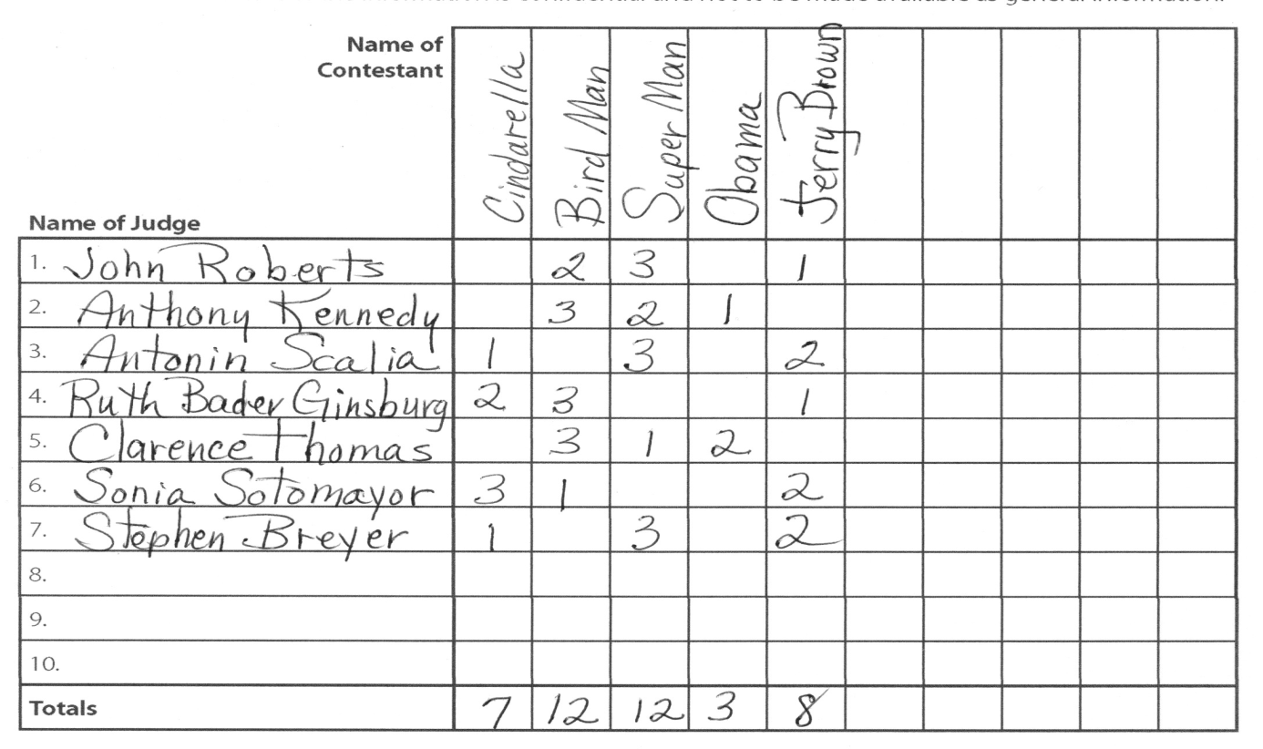
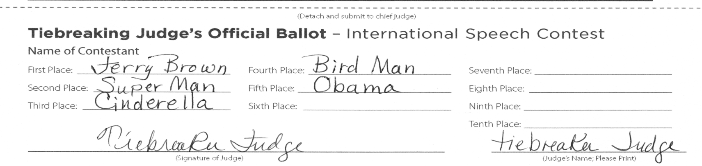
Resolving a Tie

Slide 18
 |  | Cinderella | Bird Man | Super Man | Obama | Jerry Brown
Name of Contestant
Name of Judge
1. John G. Roberts |  |  | 2 | 3 |  | 1
2. Anthony M. Kennedy |  |  | 3 | 2 | 1
3. Antonin Scalia |  | 1 |  | 3 |  | 2
4. Ruth Bader Ginsburg |  | 2 | 3 |  |  | 1
5. Clarence Thomas |  |  | 3 | 1 | 2
6. Sonia Sotomayor |  | 3 | 1 |  |  | 2
7. Stephen G. Breyer |  | 1 |  | 3 |  | 2
8
9
10
Totals |  | 7 | 12 | 12 | 3 | 8
1. Check TieBreaker Ballot to see which contestant is listed first
2. TieBreaker's Ballot:
First Place | Jerry Brown |  | Fourth Place |  | Bird Man |  |  | Seventh Place
Second Place | Super Man |  | Fifth Place |  | Obama |  |  | Eighth Place
Third Place | Cinderella |  | Sixth Place |  |  |  |  | Ninth Place
Contest Results:
Totals |  | 7 | 12 | 12 | 3 | 8
 |  |  | 2nd | 1st |  | 3rd
The tied contestant who rec'd the highest ranking gains the contested place
Any other tied contestants will be ranked in order behind that contestant.

Slide 19
End of Contests Checklist
Were there any disqualifications?
  Due to Time
  Eligibility
  Originality (75% or more must be original)
    – challenged by contestant or voting judge
Provide winners for both contests to pre-determined Announcer of results.
Are winners announced correctly?
Complete Notification of Contest Winner forms and give to Area/Division/District Governor. – Save a copy of this info for yourself in case original gets lost.
Notes:
19
Protests
See pg. 3 of briefing notes and pg. 10 of Speech Contest Rulebook.
At the end of the contest
Listen to announcement of winners and ensure correctness.
Fill out Notification of Winner forms [use information from Notification sheets filled out by contestants].
Give Tally forms with ranking of all contestants to Contest Chair.
You or Contest Chair take home and shred or tear then dispose of all ballots, timer sheets, and tally sheets.

Slide 20
Changes to Contest Rules from 2014
Page 6: a charter member of a club chartered less than one year before the club contest is permitted to compete in International Contest
Page 15: Contestants may not use digital or other devices during the TT contest

Slide 21
Rules Concerning Photographs
The Rules state:
The taking of photographs during the speeches is not permitted
However, the TM website seems to believe in an exception for video photography.
  Permission of Contest Master is required
  Written Permission of Each person videoed
  Fixed position cameras.

Slide 22
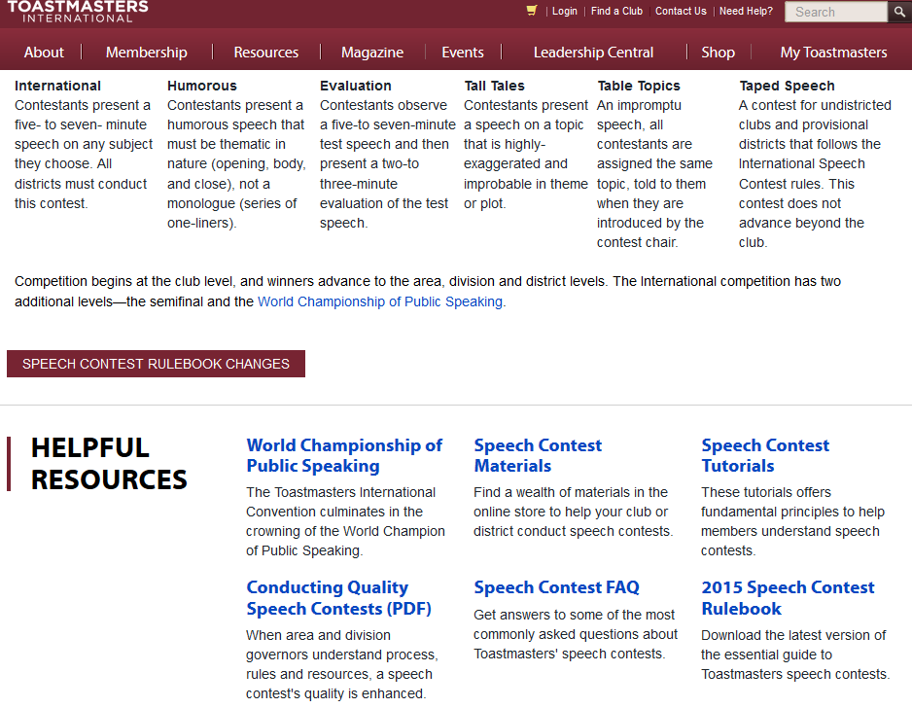
http://www.toastmasters.org/Leadership-Central/Speech-Contests

Slide 23
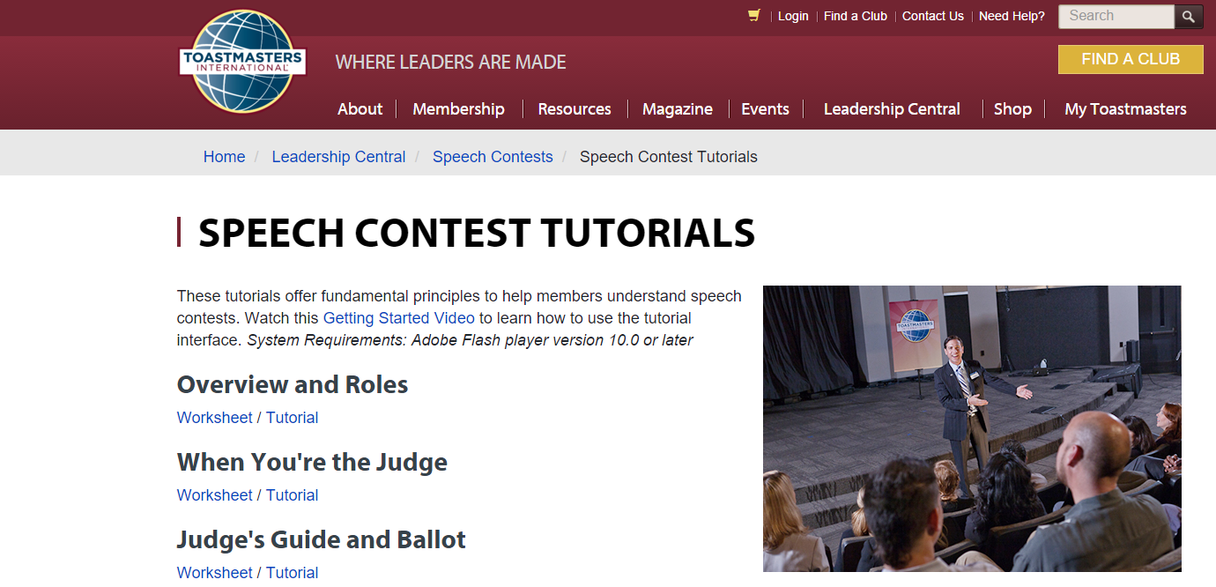
http://www.toastmasters.org/Leadership-Central/Speech-Contests/Speech-Contest-Tutorials

Slide 24
Now that you’ve Completed the Training
Members of the Founder’s and Century Districts are encouraged to go to:
http://www.AlexanderTalks.com/toast.html
And download the Judge’s Training Registration form and e-mail it in to the address at the bottom of the form so that we can have you on our lists of trained Chief Judges.

Slide 25
For Further Training
A copy of the slides for this training, and links to other Toastmasters trainings and resources can be found at:
http://AlexanderTalks.com/toast.html

