Slide 1


Judge’s Training
Facilitated by: Michael Alexander, DTM
<urban@leprechaun.com>
WHERE LEADERS
ARE MADE

Slide 2
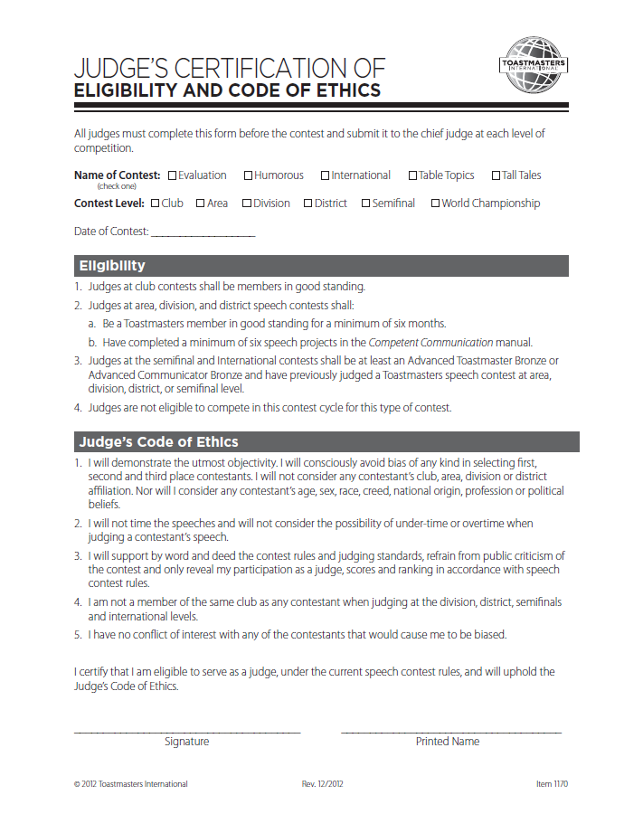
WHERE LEADERS
ARE MADE
Notes:
Before any of you can be a judge at any level in Toastmasters be sure you meet the minimum qualifications even at the club level.
Here is a judge’s certificate of eligibility and code of ethics you will need to sign.
Usually all judges beyond the club level are also documented as trained by their district LACE or District sanctioned training.

Slide 3
WHEN YOU’RE THE JUDGE
Toastmasters speech contests have three purposes:.
1. Provide competitive speaking experience for Toastmasters members
2. Provide interesting educational programs for members and the public
3. Provide the audience an opportunity to learn by observing proficient speakers
It is important that all speech contests are conducted properly and good judging is vital to this. Good judging imparts a feeling of fairness to contestants and the audience and that the right choice was made.
WHERE LEADERS
ARE MADE
Notes:
Ask the participants to raise their hands if they have ever left a speech contest feeling that the judges selected the wrong contestant as winner. Ask why they believe an incorrect selection was made. Record these on a flipchart or whiteboard. Discuss with the entire group some ways to avoid the situations the audience mentioned. Write these on a flipchart too.

Slide 4
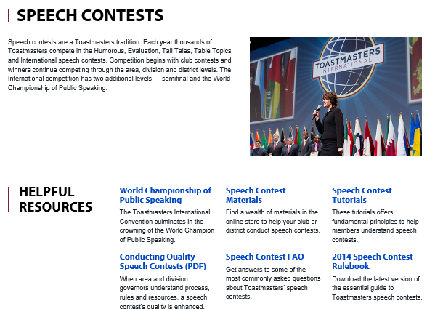
WHERE LEADERS
ARE MADE
http://www.toastmasters.org/Leadership-Central/Speech-Contests

Slide 5
Contestants. Contestants are entitled to a truly professional performance by each judge. Contestants expect, and deserve, fairness and impartiality. They should receive nothing less.
Toastmasters International. Toastmasters has a reputation for speech training, excellence in meetings, and excellence in speech contests. Bad judging creates animosity and demeans the contest, the officials, and our leaders.
The Audience. The audience deserves a good speech contest. This includes fair and unbiased judging. Whenever judges fail to make the best choice, the audience is cheated. It’s also discouraged from attending or participating in other contests.
Themselves. As a Toastmaster, judges have made a personal commitment to self—improvement. This commitment includes being dedicated to making the correct decision when judging a contest.
JUDGES HAVE AN OBLIGATION TO:
WHERE LEADERS
ARE MADE

Slide 6
JUDGING VS. EVALUATING
A judge’s purpose is to select the speaker who has given the best speech on that day. Judges do not evaluate. Evaluations appraise a speech, measuring the speaker’s presentation against his or her purpose and then advise the speaker on how to improve the speech.
Judges’ decisions are confidential and judges are not to explain their decision to contestants, or tell contestants how they could improve. To do so distracts judges from their purpose and can cause them to judge improperly. The result is a bad decision.
WHERE LEADERS
ARE MADE
Notes:
As if any audience member has been a part of or a witness to an interaction between a contestant and a judge after a contest. Ask them to briefly describe the event and then discuss with the group how the judge reacted and also give some alternative, constructive reactions that could have been used.

Slide 7
GOOD JUDGES MUST BE:
Accurate. Good judges are committed to making a correct decision. They complete the judging form correctly.
Fair. Good judges are totally impartial and don’t allow friendship, affiliation, age, sex, race, creed national origin, profession, or disapproval of speech topics to interfere with their decision.
Trustworthy. Good judges realize that all contest participants have entrusted them with the responsibility of selecting the best speaker as winner. They live up to that trust.
Knowledgeable. Good judges know the current contest rules. They study the rules before each contest, and they make no exceptions to the rules. They are familiar with the judging form and know how to judge properly.
Good Listeners. Good judges listen carefully to each speaker. They don’t become distracted.
WHERE LEADERS
ARE MADE
Notes:
Ask participants to brainstorm qualities of a good judge by asking. “If you were organizing a speech contest and had to select judges, what qualities would you look for?” Write on a flipchart and refer to them later when appropriate. The flowing qualities should appear on your list. If not, add them, and then discuss all five.

Slide 8
BARRIERS TO OBJECTIVITY:
Speaker position. When people are presented with a list or series they often recall the end of the list first because it is the most recent addition to short-term memory. Similarly, people may remember the beginning of a list better than the middle because it serves as a reference point. Judges must compensate for this effect by paying close attention to every contestant and by fully scoring each contestant when they speak.
Champion for the underdog. People tend to believe that underdogs put forth more effort than an advantaged or more powerful opponent and are thus are more deserving of success. Judges must use only the criteria on the judge's guide and ballot to select winners.
Halo effect. This is an inclination to admire all of a person's actions, work, etc., because of another admirable quality. Judges must focus on how each contestant performs using the criteria on the judge's guide and ballot. For example, if a contestant happens to be a speech teacher, DTM or past officer, this does not automatically make her contest presentation the best. Likewise, a dynamic delivery style does not signify compelling content.
Reverse halo effect. This is a tendency to disapprove of all of a person's actions, work, etc., because of an unrelated quality or action. Resist downgrading a score in one area because you are not happy with the contestant's performance in another area.
WHERE LEADERS
ARE MADE

Slide 9
BARRIERS TO OBJECTIVITY (continued):
Second time around. It is common for individuals to see the same contestant compete at different contest levels during the same contest cycle or compete from one year to the next. Judges must remember not to compare an individual's current performance or delivery to previous presentations.
Not the norm. A false consensus occurs when an individual believes that the majority of others share their own opinion, regardless of what that opinion is. For example, in some geographic areas it is typical for a contestant to stand behind a lectern when speaking. Judges accustomed to this behavior may harshly judge a contestant who does not do so. This behavior is a custom and does not relate directly to the judging standards.
Prejudices and personal preferences. Judging is a subjective process that we try to make objective. The individual opinions of each judge are based on his or her likes and dislikes and there is no way to control the tastes of judges. It is almost impossible for anyone to be totally objective so contests use panels of judges to restrict the efforts of any single judge's bias.
WHERE LEADERS
ARE MADE

Slide 10
SOME MISCONCEPTIONS
As stories and reminiscences about contests circulate, some of them transform into common-knowledge rules. These aren't part of any official rules but people accept them as such. Unfortunately, these common-knowledge rules can be purveyors of misinformation. For example, many Toastmasters believe that International Speech Contest entries must be serious or motivational or inspirational. But the contest rules state only that contestants create their own substantially original speech. There is no reference to content or style so humorous speech is definitely acceptable in a contest.
Similarly, the use of props or visuals is not restricted in any way beyond the bounds of safety and good taste. Confirm that any common-knowledge conceptions abide by official contest rules and procedures.
WHERE LEADERS
ARE MADE
Notes:
Ask for questions and/or ask the audience if anyone has had an experience with a non-documented “rule” either as a contest official or as a contestant. Use the Speech Contest Rulebook to facilitate a discussion about the rule. Spend only about 10 minutes on this activity. Depending on the audience’s experience, you may wish to devote more time to the discussion. But be sure you will still have plenty of time to cover the rest of the material. If the audience has more questions you can have them send an email to you or to World Headquarters (speechcontests@toastmasters.org). Be sure you also provide the location of the Speech Contest Rulebook online: www.toastmasters.org/rulebook.

Slide 11
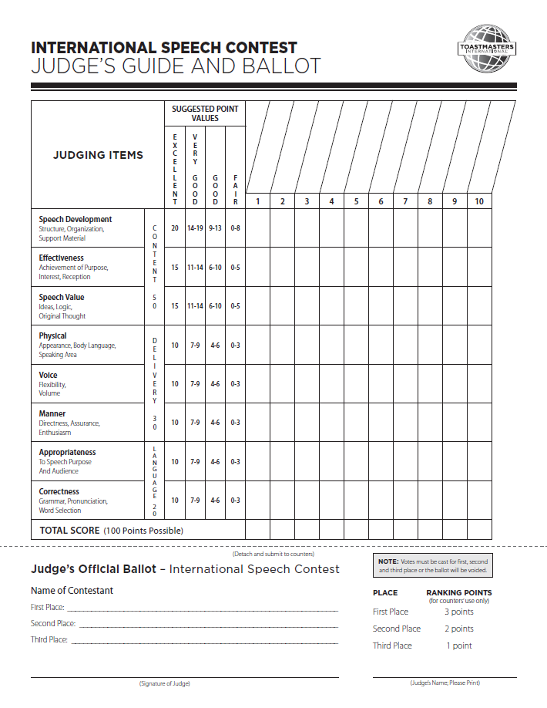

WHERE LEADERS
ARE MADE

Slide 12
THE JUDGE'S GUIDE AND BALLOT:
There are two sections to the form. The top portion is a guide judges can use to help them select a winner and will not be turned in to the counters with the ballot. The bottom portion is the official ballot.
A ballot must be complete before it is given to the counters for tallying. A ballot is complete when:
Three different contestants are listed for
first, second, and third place.
The judge has signed the ballot
If any portion of the ballot is not complete or is unreadable, the chief judge will discard the ballot.
SELECTING A WINNER
The purpose of the guide is simply to help judges make their decisions and select winners. The guide is not given to counters and judges may use the guide as they wish. There is no single method for using the guide.
WHERE LEADERS
ARE MADE
Notes:
Display the judging form visual as you explain its use in the judging procedure.

Slide 13
THE JUDGING CATEGORIES:
There are three judging categories:
Content
Delivery
Language
WHERE LEADERS
ARE MADE

Slide 14
CATEGORIES:
Content: Speech development, effectiveness, and value.
Areas to consider:
Speech Development (International 20 pts Table Topics 30 pts)
  Did the speech have a clearly defined opening, body, and conclusion?
  Were the speaker's ideas presented in an easy to follow, logical sequence?
  Did the speaker use effective transitions while moving from one concept to the next?
  Was the speech purpose clear?
Speech Effectiveness (International 15 pts Table Topics 25 pts)
  Audience reactions?
  Subject relevant to audience?
  Subject presented clearly?
  Speech purpose? (entertain, inform, persuade, inspire)
  Did the speaker achieve his or her purpose?
Speech Value (International 15 pts)
  Did the speaker have a substantive, logical, clearly defined message?
  Were the speaker's thoughts original?
  Was the speech in good taste?
WHERE LEADERS
ARE MADE

Slide 15
CATEGORIES:
Delivery: How as the content presented?
Areas to consider:
Physical (International 10 pts – Table Topics 15 pts)
  appearance, body language (appropriate and purposeful?), use of speaking area
Voice (International 10 pts – Table Topics 15 pts)
  flexibility and volume, modulation to show emotion, adequate volume? Enunciation?
Manner (International 10 pts)
  confident, enthusiastic, show concern for the audience?
WHERE LEADERS
ARE MADE

Slide 16
CATEGORIES:
Language: Reflects word choice and grammatical skill
Areas to consider:
Appropriateness (International 10 pts – Table Topics 10 pts)
  Does the word choice fit the speech, audience, and occasion? Does the word choice promote understanding of the message as the speaker intended?
Correctness (International 10 pts – Table Topics 5 pts)
  grammar, pronunciation, word selection. Does language reflect study and preparation? Effective word choice?
Note: the guide does not include a space for speech time. Timing of speeches is the sole responsibility of the timers. Judges are not permitted to time the speeches and will not consider the possibility of under time or overtime when judging a contestant's speech.
WHERE LEADERS
ARE MADE

Slide 17

WHERE LEADERS
ARE MADE

Slide 18
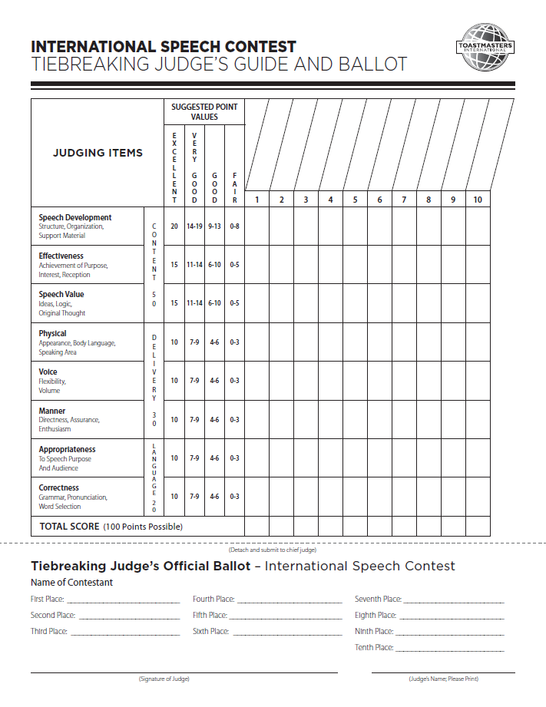

WHERE LEADERS
ARE MADE

Slide 19
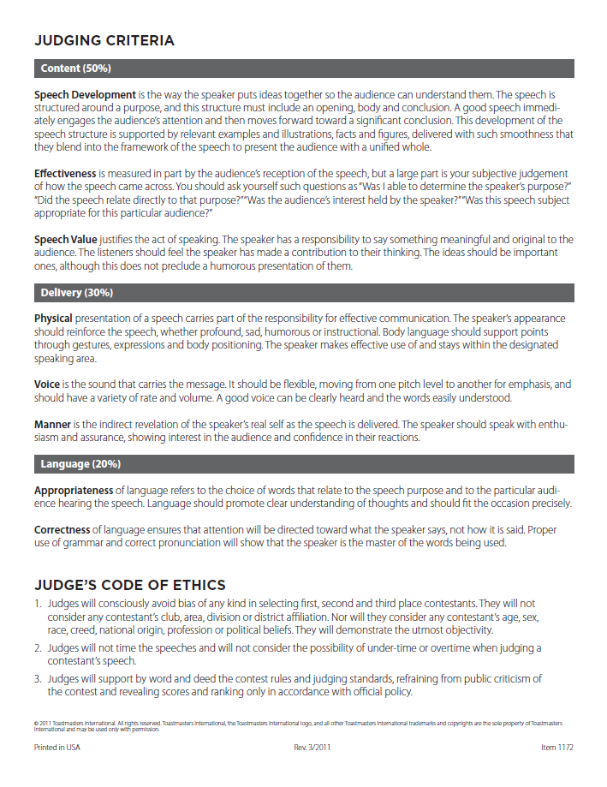
WHERE LEADERS
ARE MADE

Slide 20
TEAR OFF BOTTOM OF FORM AND
MUST BE FULLY FILLED OUT PROPERLY TO COUNT
FILL IN ALL 3 (1ST, 2ND and 3RD)
MUST BE SIGNED
PRINT YOUR NAME
FILL IN ALL CONTESTANTS
MUST BE SIGNED
PRINT YOUR NAME
WHERE LEADERS
ARE MADE

Slide 21
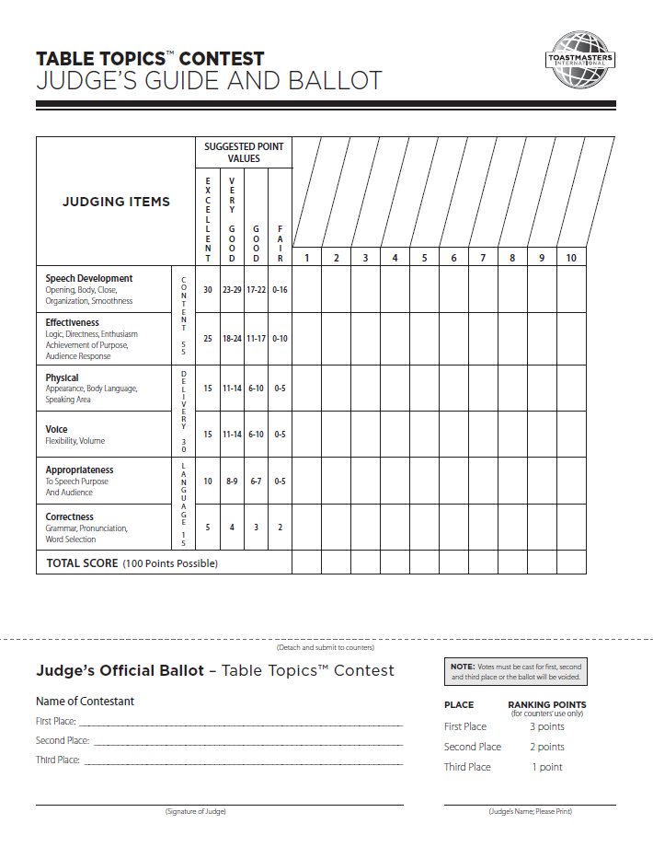

WHERE LEADERS
ARE MADE

Slide 22
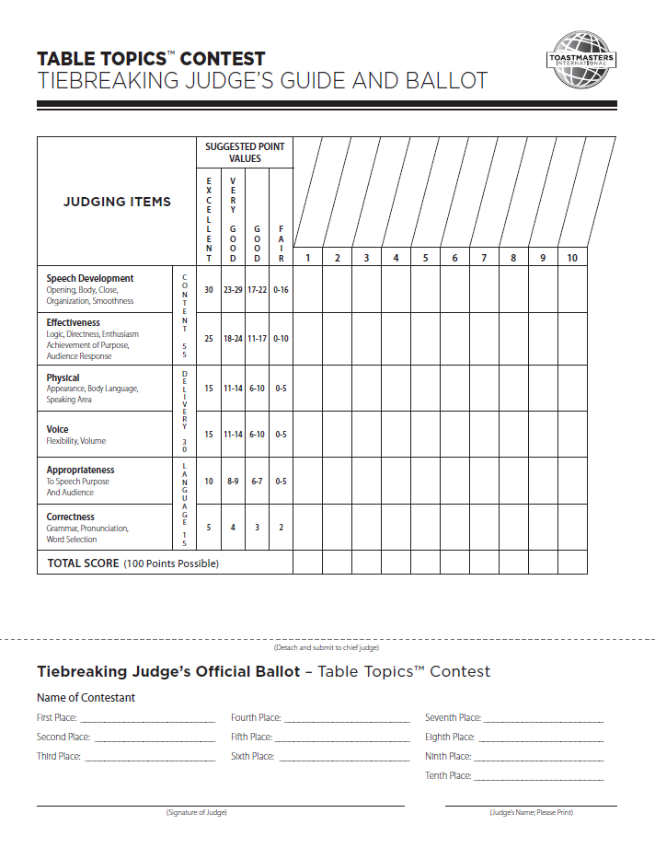

WHERE LEADERS
ARE MADE

Slide 23
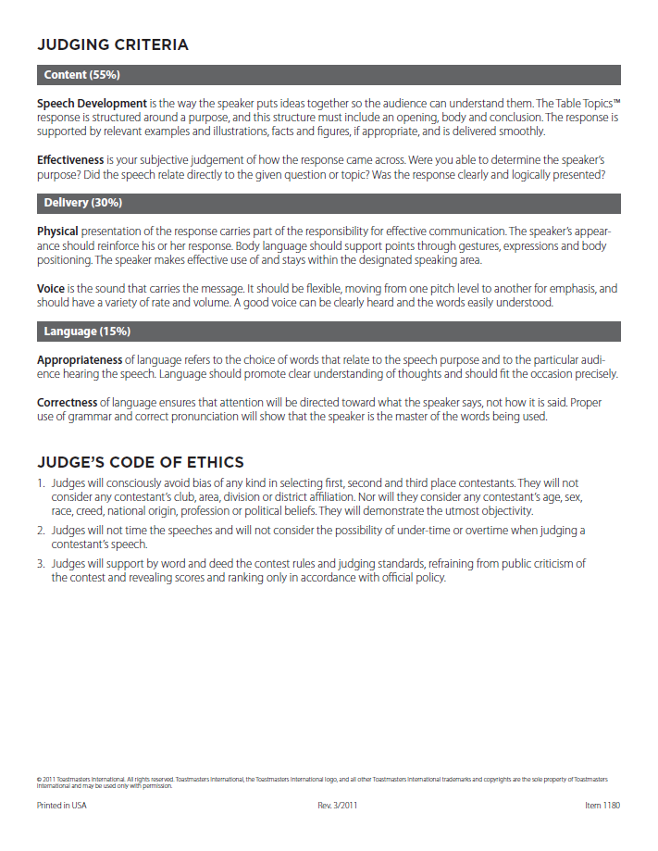
WHERE LEADERS
ARE MADE

Slide 24
TEAR OFF BOTTOM OF FORM AND
MUST BE FULLY FILLED OUT PROPERLY TO COUNT
FILL IN ALL 3 (1ST, 2ND and 3RD)
MUST BE SIGNED
PRINT YOUR NAME
FILL IN ALL CONTESTANTS
MUST BE SIGNED
PRINT YOUR NAME
WHERE LEADERS
ARE MADE

Slide 25
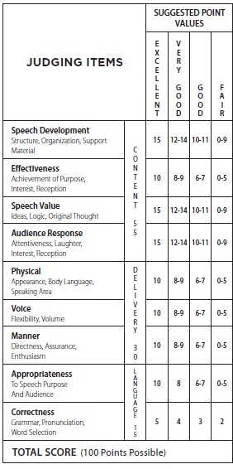
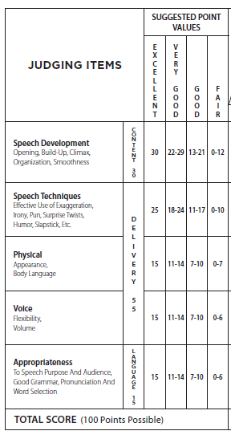
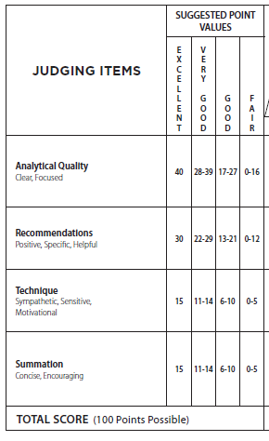
The Other Speech Contests
HUMOROUS SPEECH
TALL TALES
EVALUATION

Slide 26
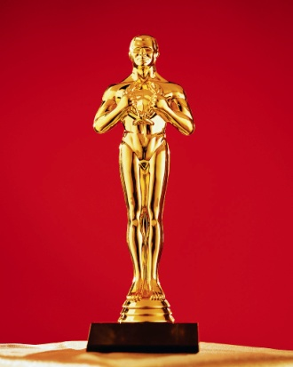
YOUR ULTIMATE JOB….
PICK A WINNER!
WHERE LEADERS
ARE MADE
Notes:
As time permits, have the audience discuss some of the following scenarios and pose solutions. Write topics and answers on a flipchart.
1.
Q. What are the reasons for which a contestant may be disqualified?
A. ▪Eligibility
▪Originality
▪Timing
2.
Q. What happens if:
Four judges sign and print their names on their ballots.
One judge only prints his name on his ballot, but does not sign it.
One judge neither signs nor prints his name on his ballot.
One judge only signs her name on her ballot.
Only five of the seven ballots will be counted. The ballots that were not signed must not be counted.
3.
Q. What happens if one judge leaves the blank for the third-place winner’s name empty on her ballot?
The ballot is not counted. Ballots cannot be counted if they do not contain complete information regarding the ranking of contestants.
4.
Q. What is the appropriate action to take if a member approaches a contest official and asks to see the points awarded to contestants?
All contest forms are confidential, including ballots. Judges are not to explain their decision to contestants, or tell contestants how they could improve. After the contest, the ballots are to be disposed of. They cannot be made available to contestants or other individuals. (This is true for timing reports as well.) The appropriate response would be to politely explain the policy of confidentiality regarding judges’ decisions and all information on official contest forms (counter’s tally sheet, timer’s record).
5.
Q. What is the appropriate action for the following situation? Contest results are announced and the contest meeting is adjourned. After this an individual from the audience complains that judging was unfair.
Protests are limited to contestants and judges and may regard eligibility and originality only. Audience members are simply observers and have no rights to protest. Valid protests, from judges or contestants, must be lodged prior to that announcement before the meeting at which the contest took place is adjourned. After that, all judging decisions are final.

Slide 27
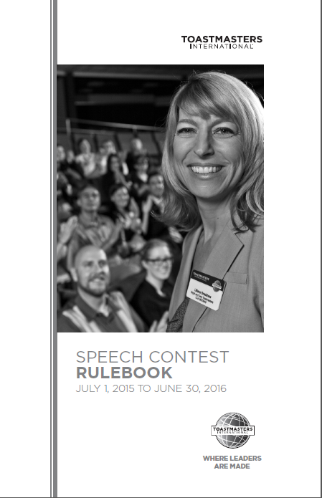
WHERE LEADERS
ARE MADE
http://tinyurl.com/TMrules2015

Slide 28
Changes to Contest Rules from 2014
Page 6: a charter member of a club chartered less than one year before the club contest is permitted to compete in International Contest
Page 15: Contestants may not use digital or other devices during the TT contest

Slide 29
WHERE LEADERS
ARE MADE

